Slide 1
JourneyBox – Smart Travel Companion App
CSE7302- University Project
Review-1
Batch Number: CSE_164
Under the Supervision of,
Ms.Delsy Jyothi
Professor / Associate Professor / Assistant Professor
School of Computer Science and Engineering
Presidency University
Roll Number | Student Name
20221CSE0626 | THEJAS C
20221CSE0624 | T M TEJASHWINI
20221CSE0628 | VINAY K HIREMATH
Name of the Program: CSE7302-University Project
Name of the HoD: Dr. Blessed Prince
Name of the Program Project Coordinator: Mr.Muthuraju V
Name of the School Project Coordinators: Dr. Sampath A K , Dr. Geetha A

Slide 2
Content
Problem Statement
Objectives
Background and Related work for title Selection
Analysis of Problem Statement
Git-hub Link
Timeline of the Project
References

Slide 3
Problem Statement Number: SIH25082
Organization: Government of Kerala
Category (Hardware / Software / Both) : Software
Problem Description:
Travelers often struggle to manage and access trip-related information such as itinerary, booking details, travel documents, expenses, and emergency contacts. This information is usually scattered across messages, emails, screenshots, and different apps, making it difficult to retrieve at the right time.
There is a need for a mobile travel application that can be installed on smartphones to capture, store, and organize trip-related data, provide real-time assistance during the trip (reminders, navigation support, offline access), and improve overall travel convenience, safety, and trip management efficiency.

Slide 4
Objectives
To develop a mobile application that can capture and store complete trip-related information (itinerary, bookings, documents, notes).
To provide organized trip management through a single dashboard for each journey.
To assist travelers with reminders and real-time trip support during travel.
To enable offline access to important trip details in low-network areas.
To help users track trip expenses and budgets for better financial planning.
To improve traveler safety by providing emergency contact and SOS support.

Slide 5
Background and Related work for title Selection
The growth of tourism and travel in recent years has increased the use of mobile applications for planning and managing trips. However, most travelers still face difficulties in organizing trip-related information because critical data such as booking confirmations, travel documents, itineraries, expenses, and emergency details are usually stored in different platforms like emails, WhatsApp messages, screenshots, notes, and multiple apps.
This scattered nature of information leads to:
confusion during travel
missed schedules (check-ins, travel timings)
difficulty accessing details instantly
problems in low-network/remote areas
poor expense tracking and budgeting
Therefore, there is a strong need for a single integrated mobile application that can capture, store, and assist users with all trip-related details.

Slide 6
Analysis of Problem Statement
Technology Stack Components:
Mobile Application (Frontend)
Android Studio
Language: Java
UI: XML Layouts + Material Design Components
Backend / API
Spring Boot (Java) / Node.js (Express)
REST APIs
Database
Firebase Firestore

Slide 7
Analysis of Problem Statement (contd...)
Software and Hardware Requirements:
Software Requirements
Android Studio
Java / Kotlin
Git & GitHub
Postman (API testing)
Google Maps API
Hardware Requirements
For Development
Laptop / PC
Minimum: 8GB RAM, i5 Processor (or equivalent)
Recommended: 16GB RAM for smooth Android Studio performance
Stable Internet connection
For User (Mobile App)
Android smartphone
Android 8.0+ (Oreo and above)
GPS support (for location services)
Camera access (for document capture)

Slide 8
Analysis of Problem Statement (contd...)
Key Challenges
Trip details are scattered across multiple apps (emails, chats, screenshots).
Users face difficulty retrieving tickets, hotel details, and itinerary quickly.
Lack of offline availability in low-network areas.
No centralized system for trip budget & expense tracking.
Need for travel reminders and safety assistance.

Slide 9
Github Link
The Github link provided should have public access permission.
Github Link

Slide 10
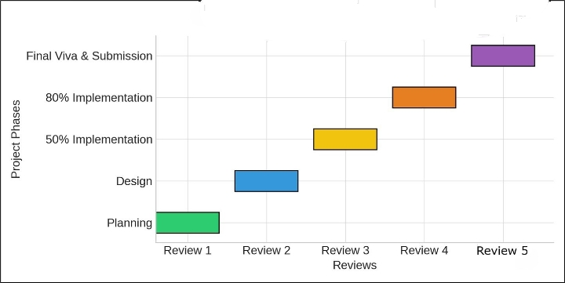
Timeline of the Project (Gantt Chart)

Slide 11
References (IEEE Paper format)
[1] C. Wang, Z. Li, and J. Wang, “Smart Tourism: Foundations and Developments,” Electronic Markets, vol. 30, no. 3, pp. 401–404, 2020.
[2] X. Y. Zheng, K. H. Lim, and J. Yang, “Mobile Travel Applications and Their Impact on Tourist Experience: A Review,” Tourism Management Perspectives, vol. 35, pp. 100–110, 2020.
[3] M. Tussyadiah and D. Wang, “Tourists’ Adoption of Mobile Applications: Motivation, Satisfaction and Behavioral Intention,” Journal of Travel Research, vol. 55, no. 8, pp. 1–14, 2016.

Slide 12


